Slide 1
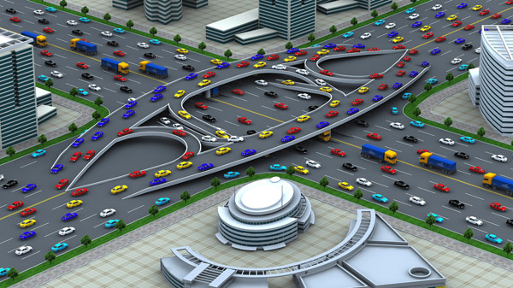
Traffic Engineering
University of Diyala
College of Engineering
Civil Engineering Department

Slide 2
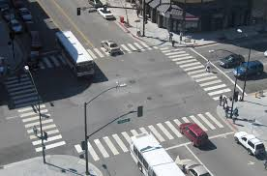
Traffic Intersections
An Intersection is the general area where two or more highways join or cross each other, at same level or different level.
There are three classes of intersections:
1-Intersection at grade

Slide 3
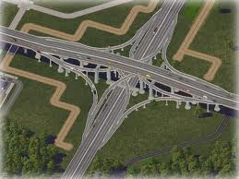
2-Grade separations without ramps
3-Interchange.

Slide 4
Factors of Intersection Design
Driver and vehicular characteristics
Driver: (age, gentle, driving skill, experience)
Vehicle: (size, speed, acceleration/ deceleration)
Sight distance requirement
Traffic volume and pedestrian movement
Approaching speed and angle.

Slide 5
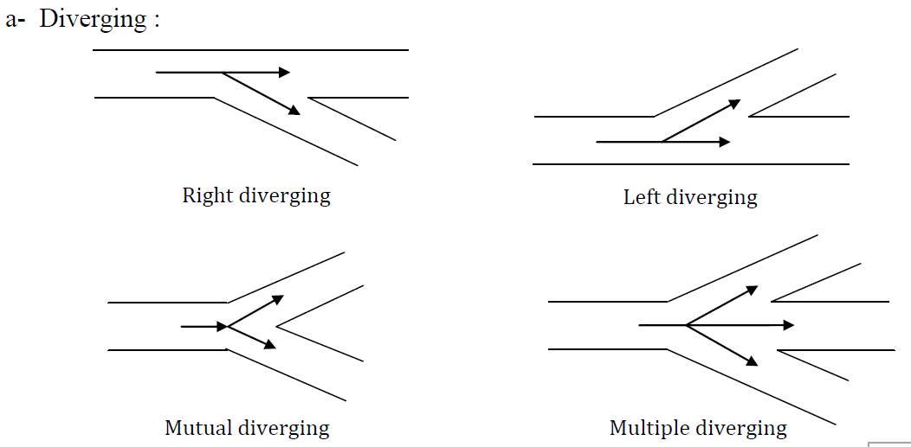
Characteristics \\ Maneuvers:

Slide 6
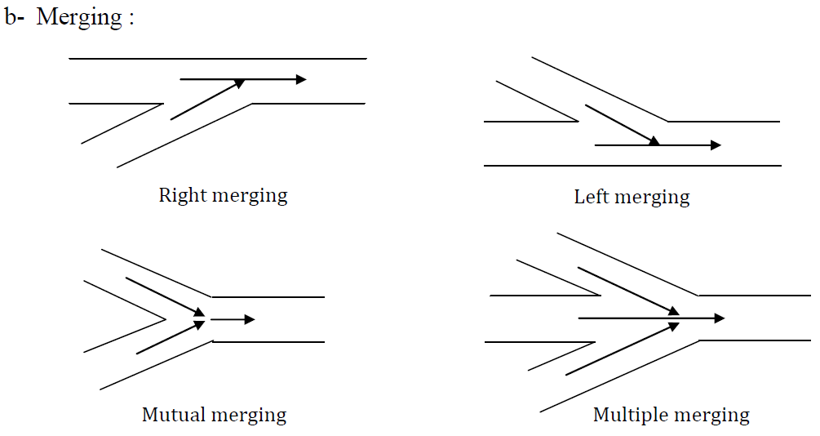
Characteristics \\ Maneuvers:

Slide 7
Characteristics \\ Maneuvers:

Slide 8
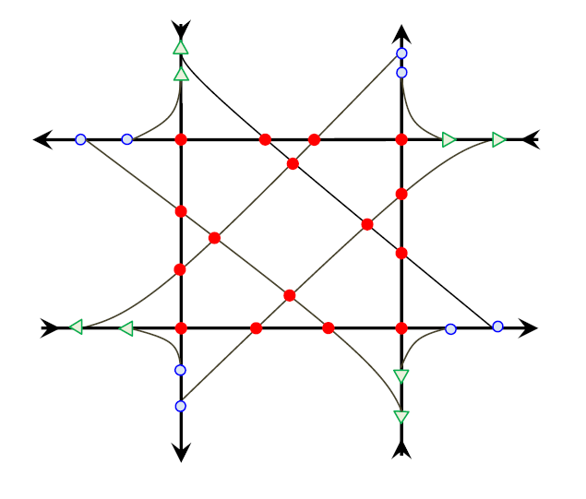
Characteristics \\ Conflict Points:
It is potential accident spots that occur on vehicle paths at diverging, merging, and cross location.
16 Crossing Points
8 Diverging Points
8 Merging Points

Slide 9
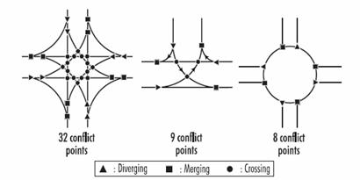
Characteristics \\ Conflict Points:
The conflict points for 4-legs Intersection & 3- legs Intersection & Roundabout

Slide 10
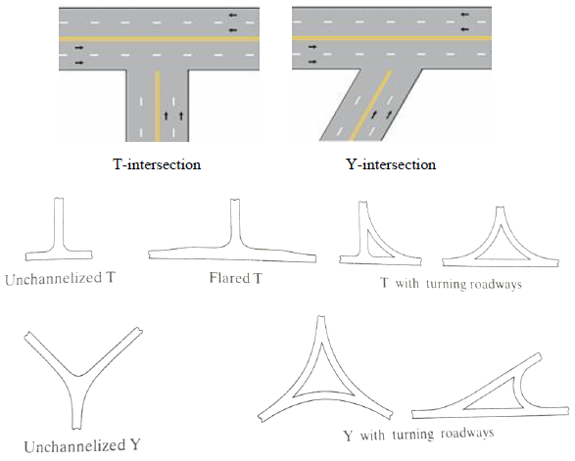
Types \\ 3- Legs Intersection

Slide 11
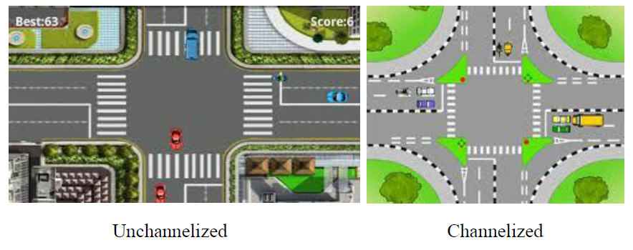
Types \\ 4- Legs Intersection

Slide 12
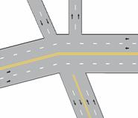
Types \\ Multi- Legs Intersection

Slide 13
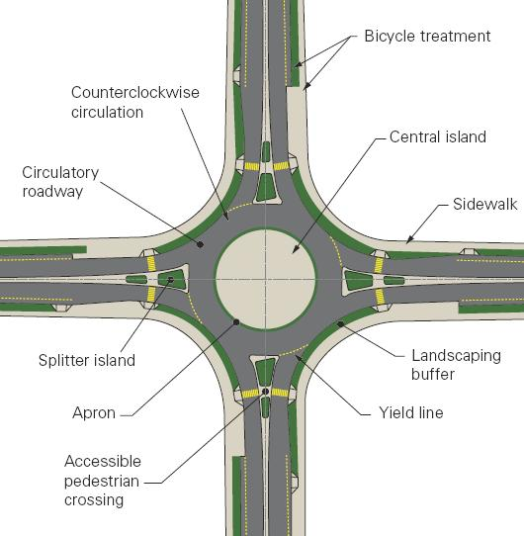
Roundabout

Slide 14
Questions - ?

Slide 15
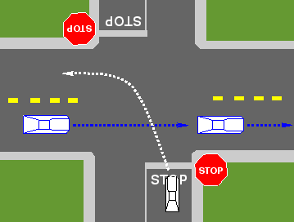
Categories of Intersection
1- Priority Intersection:
Occur where one of the intersecting roads is given definite priority over the other.
(Two way stop controlled intersection- TWSC)

Slide 16
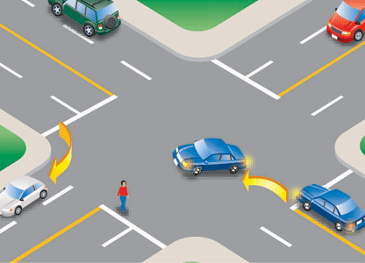
Categories of Intersection
2- Uncontrolled intersection:
Are the most common type of intersection usually occurs where the intersecting roads are relatively equal importance and found in areas where there is not much traffic.

Slide 17
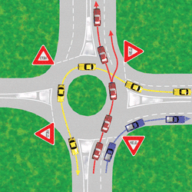
Categories of Intersection
3- Space sharing intersection:
Are intended to permit fully equally priority and to permit continuous movement for all intersecting vehicle flows; example would be rotaries and other weaving areas.

Slide 18
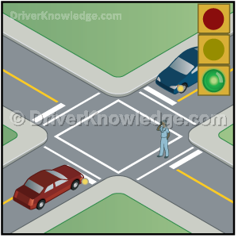
Categories of Intersection
4- Time Sharing Intersection:
Are those at which alternative flows are given the left of way at different point in time. This type of intersection is controlled by traffic signal or by police officer.

Slide 19
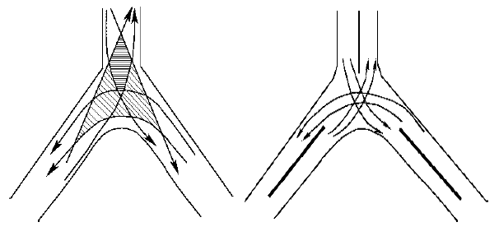
Design principles of Intersection
1- Reduction of the Area of Conflict:
The impact area is decreased when Channelization is provided, and hence the probability of conflicts is also reduced.

Slide 20
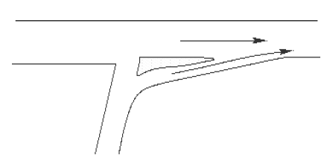
Design principles of Intersection
2- Merging traffic streams at small angles:
Merging at small angles permits the flow of traffic streams with minimum speed differentials. Hence, the gap acceptance time is also small in such cases.

Slide 21
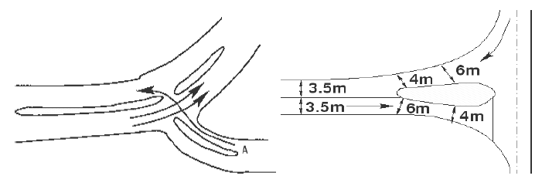
Design principles of Intersection
3- Reduction of the speed of incoming traffic by bending or funneling its path:

Slide 22
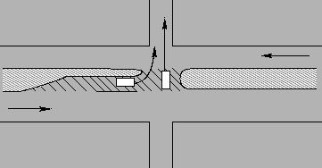
Design principles of Intersection
4- Protection for turning vehicles/crossing conflicting traffic streams:
Provision of a refuge area between the two opposing streams allows the driver of a crossing vehicle to select a safe gap in one stream at a time and also provides a safer crossing maneuver.

Slide 23
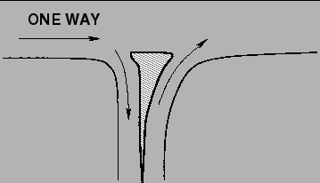
Design principles of Intersection
5- Discourage prohibited turns by island placement and shape:
Undesirable and prohibited turns can be discouraged by the proper selection of shape and location of the islands.

Slide 24
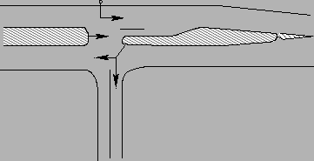
Design principles of Intersection
6- Providing locations of traffic control devices:
Channelization may provide locations for the installation of essential traffic control devices, such as stop and directional signs, signals etc.

Slide 25
Questions - ?

Slide 26
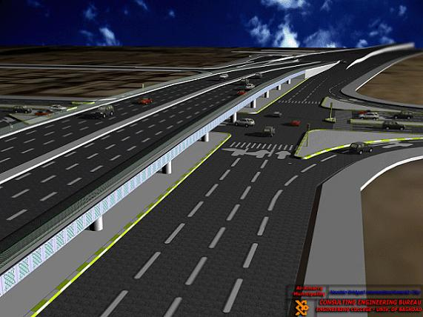
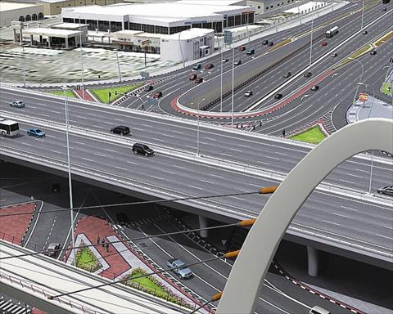
Grade- Separated Intersections

Slide 27
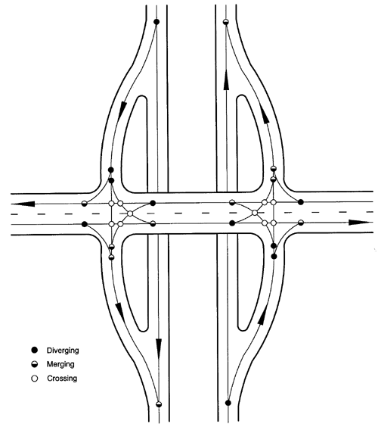
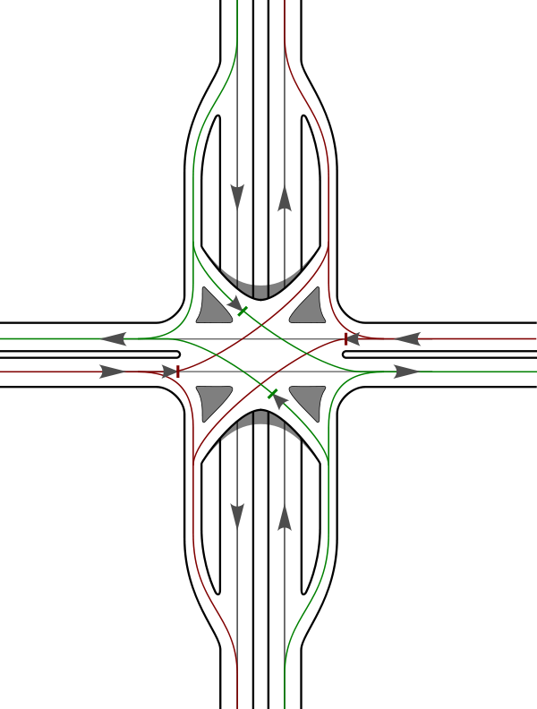
Diamond

Slide 28
Partial Cloverleaf

Slide 29
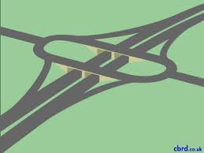
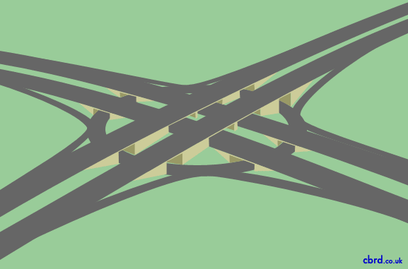
Rotary

Slide 30
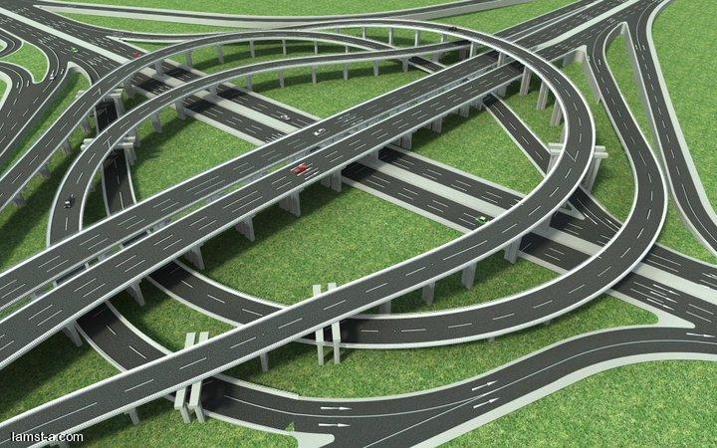
Interchange

Slide 31
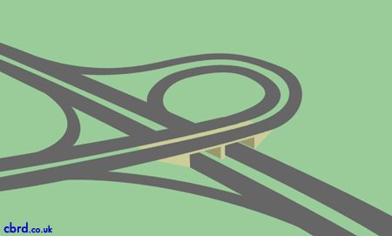
Trumpt Interchange

Slide 32
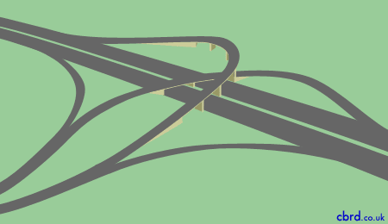
Three Leg Directional Interchange

Slide 33
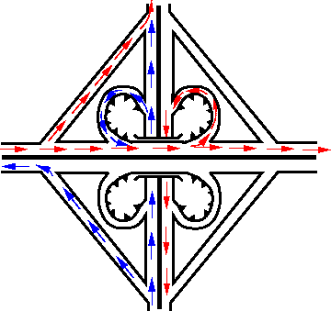
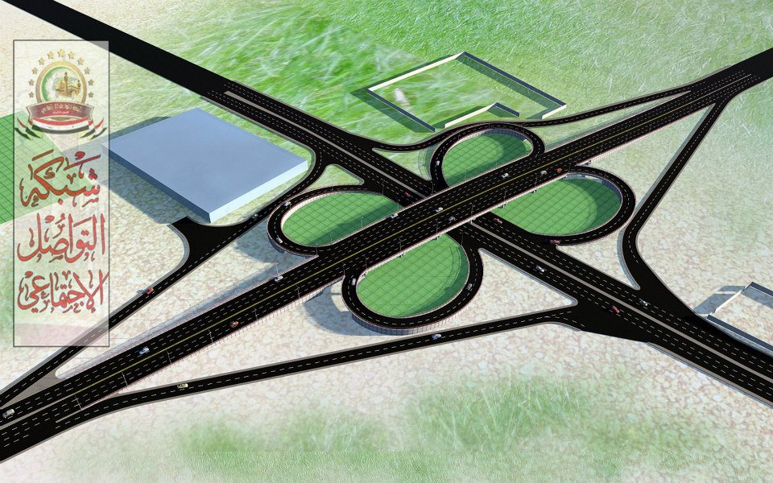
Cloverleaf Interchange

Slide 34
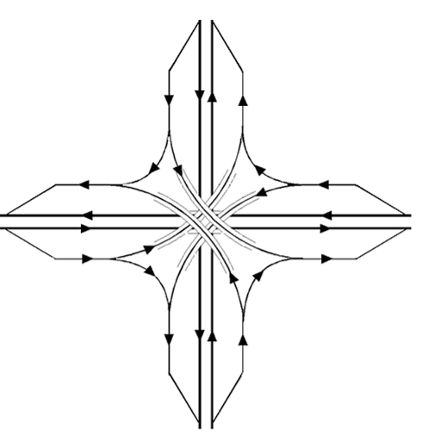
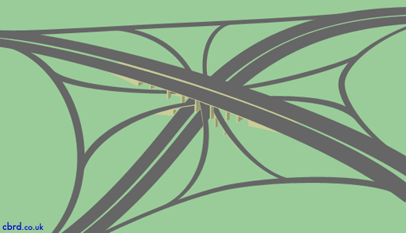
All Directional 4-Legs

Slide 35
Questions - ?

